Slide 1


PRIVATE ELEVATOR SYSTEM EKT 222 Mini Project
NAME | MATRIC NO.
TAN YI JIE | 191020976
MUHAMMAD AZIM DANIAL AZMI | 191020926
HARVIN RAJ A/L MAHENDRAN | 191020892
MUHAMMAD AMIR DZAKWAN BIN ALIAS | 181021093
NAILA MURTADHA SAEED ALAGHBARI | 191020053-5

Slide 2
Introduction
Elevator that need to identify a user in order to make it operation.
Private elevator system:
Purpose: Fullfill the VVIPs’ demands or some of the government building.

Slide 3
Objective
Objective 1
Objective 2
Objective 3
To study the simulation for operation and improvement of elevator.
To investigate the approach to design for the elevator.
To simulate the emergency situation by using interrupt as the signal when someone hacking the elevator.

Slide 4
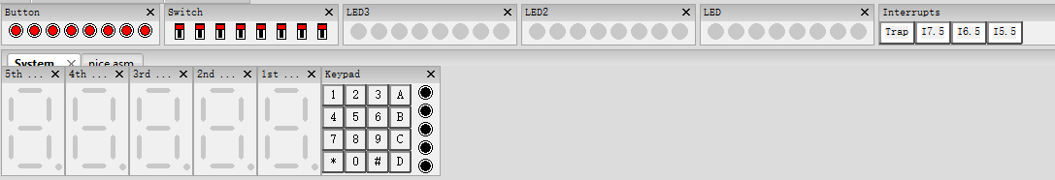
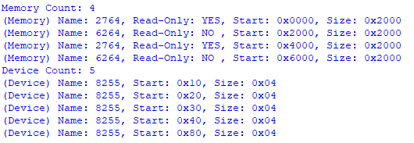
Design of System
The system is made by using My1sim85 simulator and assembly language.
The system consists of 1 port of button, 1 port of switch, 3 ports of LEDs, 5 seven segments, 1 keypad, and an interrupt.
The system consists of 2x8kb RAM for 16kb RAM and 2x8kb ROM for 16kb ROM.
The system utilizes the whole 5 PPIs devices.

Slide 5
Methodology
The user is required to input the password.
The LED2 is used for the password input to see whether the input is correct or not. If the password is incorrect, the LED2 will be blinking and display “Error” on the seven segment display.
There are five seven segments and were used to display the output value from the incorrect password and the number of floors.
After the correct password been entered, the first button is pushed and the seven segment display will display the current level of the elevator (1).
The switches are used to switch between levels from level 1 to level 4. For decrement, the third button has to be pushed and proceed for the switches.
The LED is used to display the level of current floor and will switch to the left as the floor increases and vice versa.

Slide 6
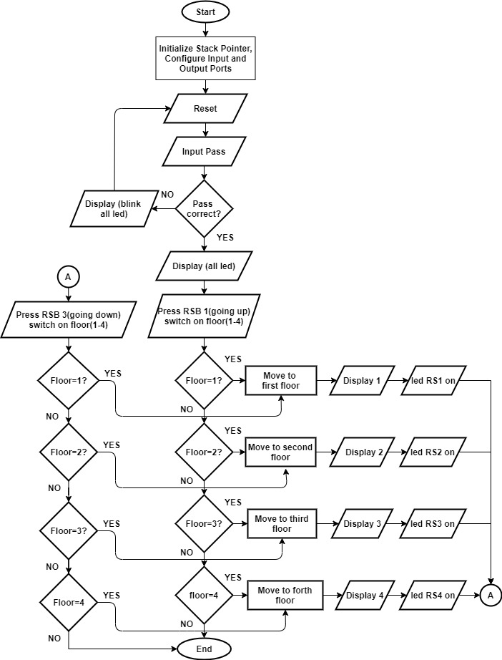
Flowchart

Slide 7
Approach (Design, Theory)
Definable and Detail Oriented
Safety Measures
Easy Handling

Slide 8
Conclusion
Working with the microprocessor to better understand each function of 8085 microprocessor.
2) Minimal equipment for maximum efficiency by optimizing specific characteristics of microprocessor

